Slide 1
Clothing E-Commerce Website

Slide 2
Overview
Introduction
Technology
Analysis
System Design
Database
Demo

Slide 3
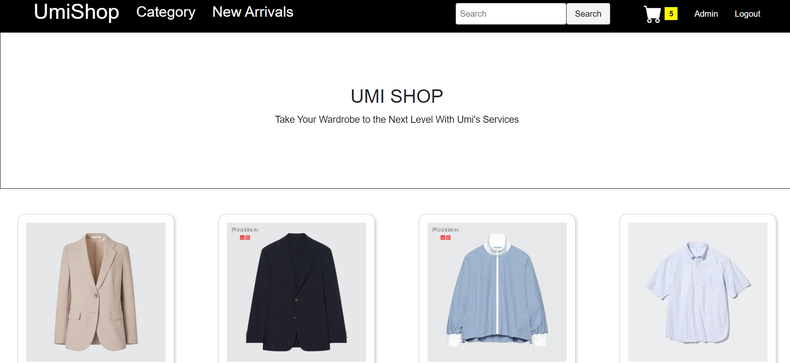
Introduction

Slide 4


Technology

Slide 5


Technology

Slide 6
Analysis
Req.ID | Requirement Name
001 | Register and login an account
002 | Product Catalog
003 | Shopping Cart
004 | Payment Gateways
005 | Order Management
006 | Item Search Function
Functional Requirements

Slide 7
Analysis
Req.ID | Requirement Name
008 | Performance
009 | Security
010 | Usability
011 | Reliability
012 | Scalability
Non-Functional Requirements

Slide 8

Database

Slide 9
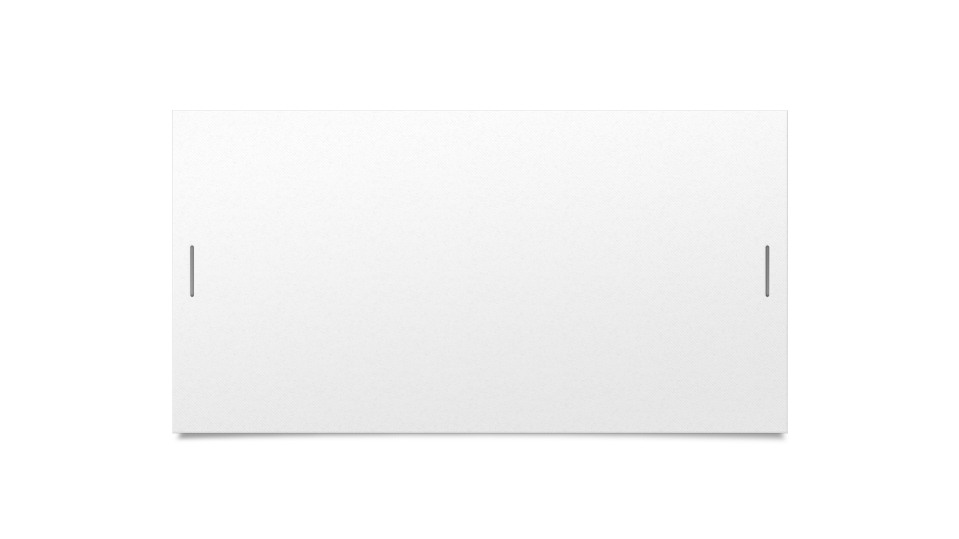

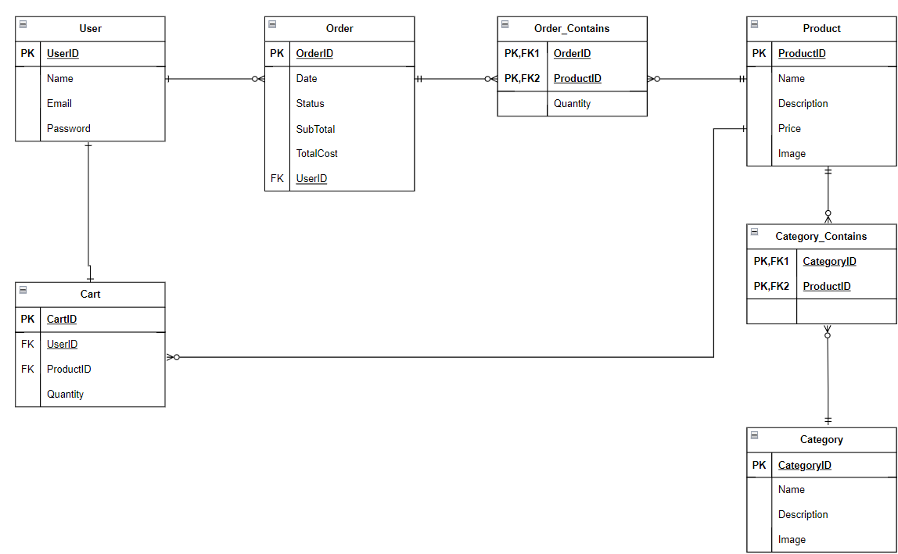



Slide 10
Features
Authentication
Search
Product Catalog
Cart & Product Browse
Admin Dashboards
CRUD

Slide 11
System Design

Slide 12
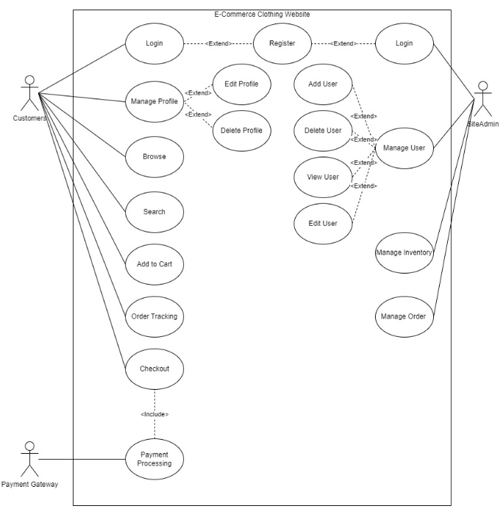
Use Case Diagram

Slide 13
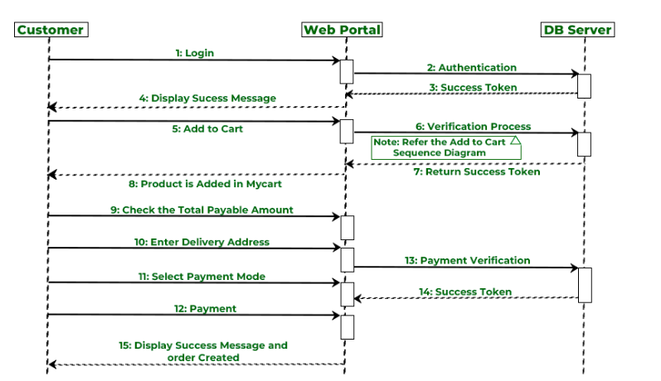
Sequence Diagram

Slide 14
Demo

Slide 15
Future Improvements
User-side dashboards
Better UI designs
Search Engine Optimization
Improve Authentication

Slide 16
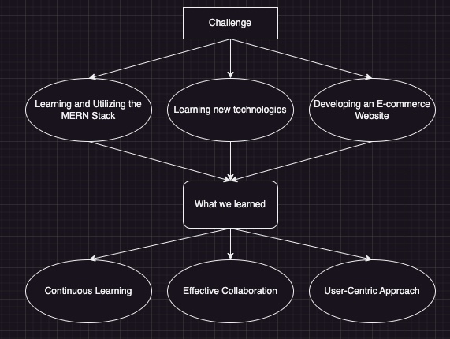
Conclusion

Slide 17

Thank you for listening.
Is there any question?

